Slide 1
Slide 7
Slide 6
Slide 5
Minor PROJECT
Presentation
Slide 4
Emergency Location Tracker
Slide 3
Slide 2
Slide 1

Slide 2


Slide 7
Location Tracker
An android Smartphone has immense potential
Slide 6
Basic Idea
Reception of coordinates
Slide 5
An app which lets the user send location in emergency situations
The coordinates once sent will be converted to the pinpoint location of the place
Slide 4
Whats New
Default Templates to save time
Sending location is easy with many exixting apps but without internet they all fail
Predefined messages are fed for improved convenience. Custom msgs can also be sent.
Slide 3
Slide 2
How it works
Exact location?
Location of any place requires the GPS coordinates of Latitude & Longitude of a particular geographical area
The location can assumed to be exact considering that locations are updated in our database timely.
Slide 1

Slide 3
Slide 7
Location Updates
In Every 3 seconds Location is updated using Stack Data Structure
Slide 6
Location is sent via SMS if network is week and internet is non functional
Slide 5
Known Location
Approx Location
Slide 4
Slide 3
Lost location
Slide 2
Till this point connectivity
is seamless and location is fetched
Based upon the previously fed location
the near correct location can be found
Slide 1

Slide 4
Slide 7
What’s Different
if real-time location is not being traced by google maps then fetching last location isn’t possible, our app traces the location coordinates and sends it via sms when connection is weak/lost
Slide 6
Connection Weakens
Last fetched location sent via SMS
Recievers are Informed
Slide 5
New location can be precisely assumed
Slide 4
Slide 3
Rescue
Good connection
Once it is known that the person can be in danger relief measure can be taken
Slide 2
Everything is fine
Slide 1

Slide 5



Slide 7
Team Members
Slide 6
Slide 5
01
02
03
Slide 4
Slide 3
Harsh Sharma
Abhishek S. Arya
Anukool R. Singh
Slide 2
Slide 1

Slide 6
Slide 7
What can you expect from this contraption
Slide 6
Efforts
Skills
Feedback
Slide 5
Slide 4
Slide 3
This project can majorly contribute in helping people stuck in remote area where internet is feeble and no help is present.
It is an example of programming knowledge put to use
Do tell us your comments as to how we can improve
Slide 2
Slide 1

Slide 7
Slide 7
Future Updates
In the later version of this project improvisations can be done with respect to the basic functionalities like voice recognisation.
Slide 6
Stage
Stage
Slide 5
1
2
Slide 4
Emergency Messaging
Geo location Fetching
1 click message sending option
Slide 3
GPS coordinates will be sent when connection is poor such that new location can be assumed
Slide 2
Slide 1

Slide 8
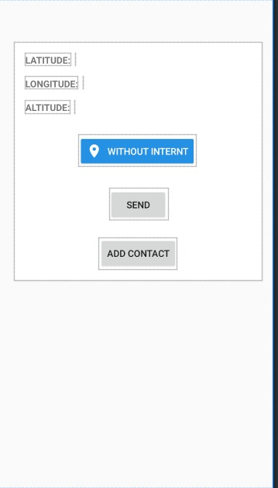
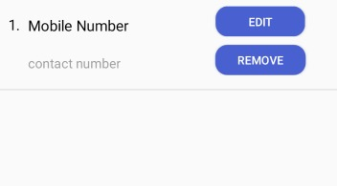
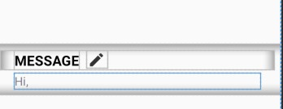
PROGRESS REPORT
In terms of progress we have made our application to behave in such a way that we no longer have to feed the contact details time and again, also the provision of custom templates is introduced.
PR
Slide 6
Slide 5
Slide 4
Slide 3
Slide 2
Slide 1

Slide 9
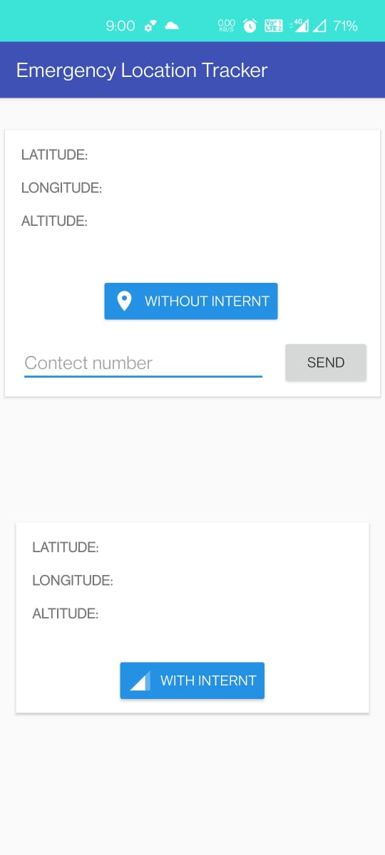
IMPLEMENTAION
This is how the application’s interface is going to look like
In the first screen the user will get the options of fetching the GPS coordinates with the help of internet and without the help of internet
When the user chooses to get the location with the help of internet the Geo-Location of that place will the be fetched with the help of internet.
If the user happens to choose to get GPS location without the internet then with help of the embedded sensors the location will be displayed.

Slide 10
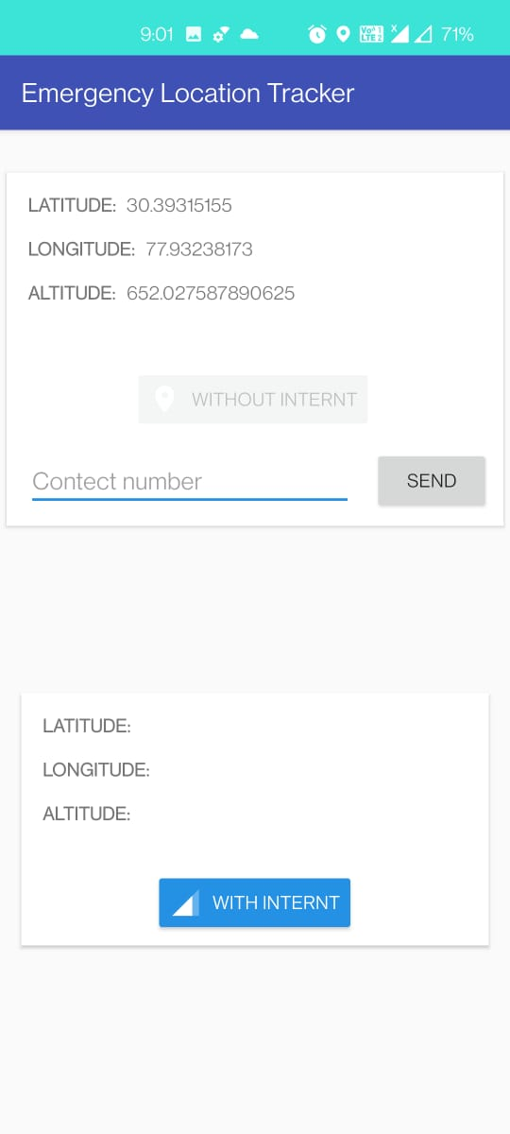
Fetching without network
Here the user chose to get the GPS location from the Smartphone’s sensor, hence the location coordinates will be displayed with the help of the sensors of the mobile phone.

Slide 11
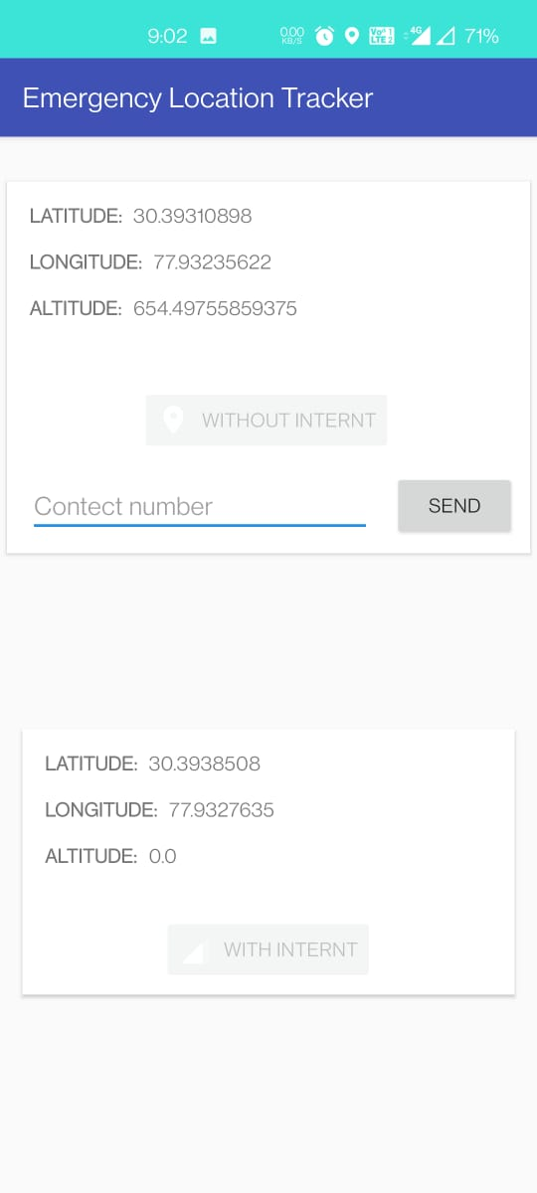
Location is same in both cases
Here the details in both the scenarios are exactly the same, that is, by the help of internet and by the help of sensors of phone.

Slide 12
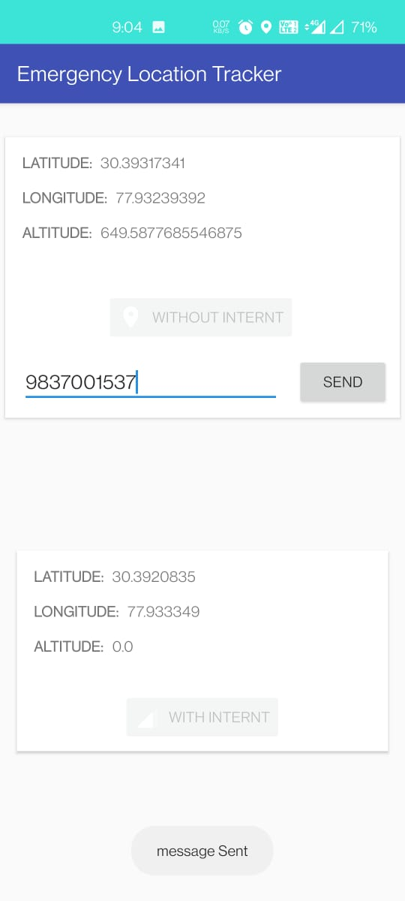
Feed Contact number whom you want to send emergency message
Now if the user wants to send the location coordinates to some person, there will be an option of doing so.
Hence with the help of SMS location coordinates will be sent in the form of a link which can be loaded onto the Google Maps.
So, tracking of individuals becomes very easy even if internet connection is not very great.

Slide 13
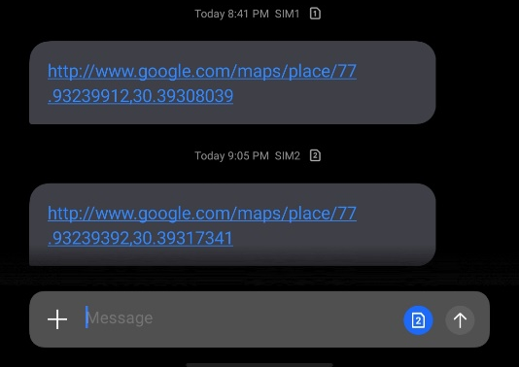
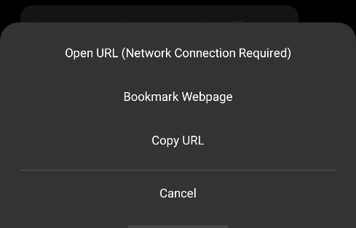
This type of message will be sent to the other person so that they can click on this link and get redirected to the Google Maps App to get the accurate location of the place where the person in need of help is present.

Slide 14
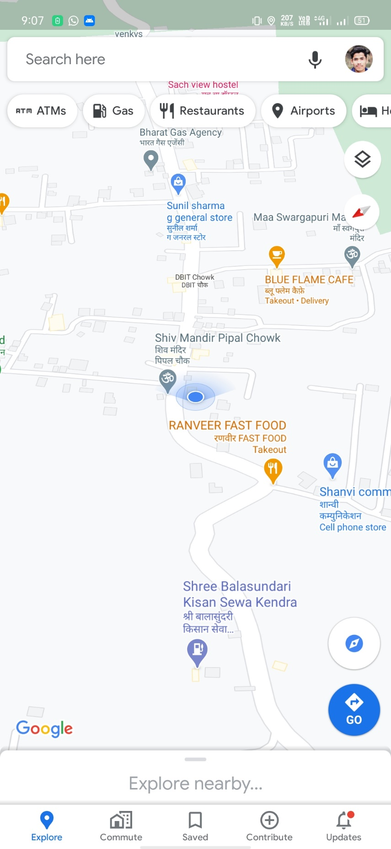
Exact Location is Retrieved in Google Maps
As depicted from the screenshot, upon clicking on the link the user is redirected to the Google maps to get the pin point location of the place where the person is actually present.

